Slide 1

Subscriber Optimization: Rosetta Stone
Group 2
Nick Bamont, Samara Othmani, Austin Simpson, Christian Watson,
Henry Holt & Karla Carmona

Slide 2

Data
Subscriber Information, App Activity, & Data Dictionary
General Stats:
Subscriber Info
40k + entries
Columns w/ Nulls: Purchase Amount, Currency, Free Trial Start/Expiration, Country
App Activity
Session Platform, Activity Type, Session Date
Insights into individual user activity, led us to a different approach
Notes:
Overview of data - mention data exploration
karla

Slide 3
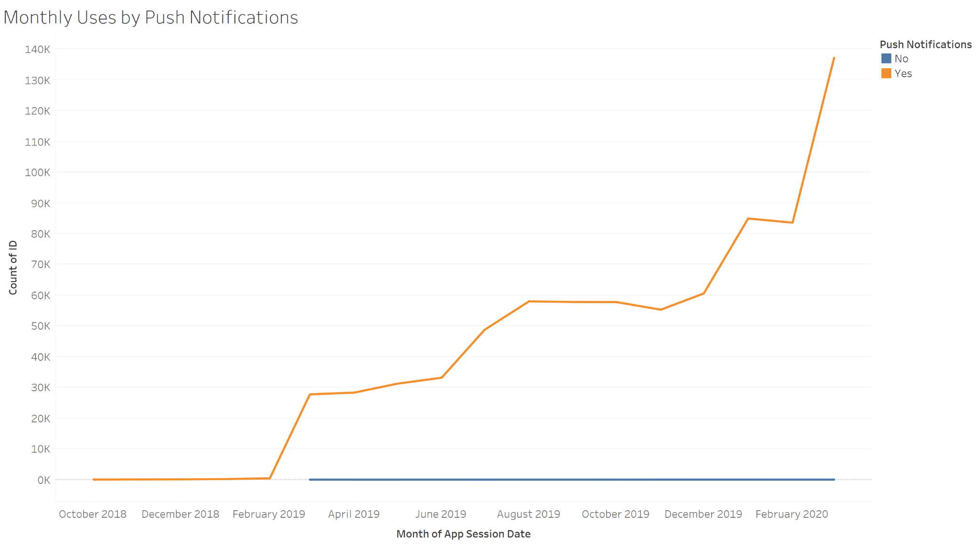
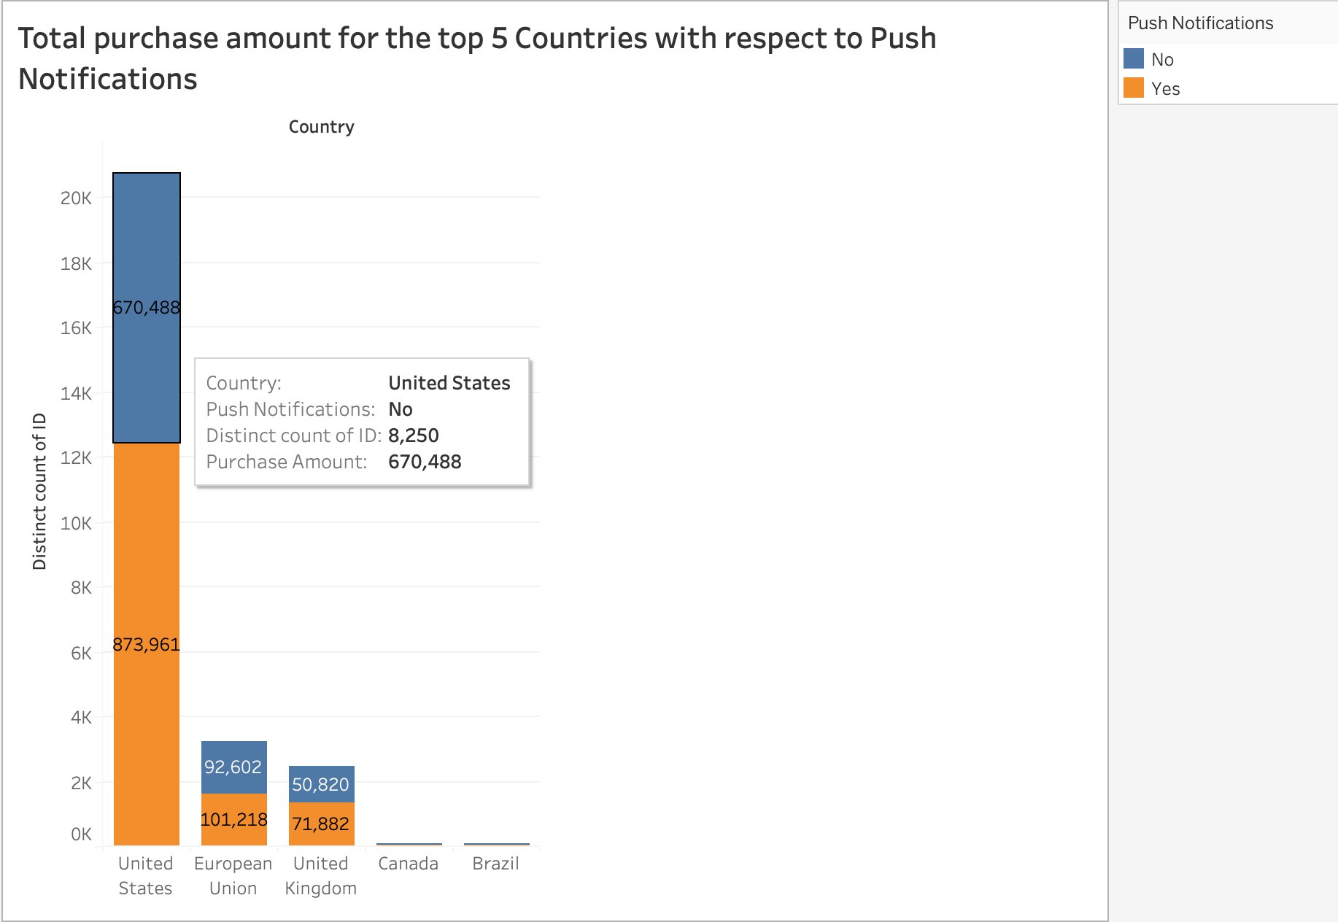
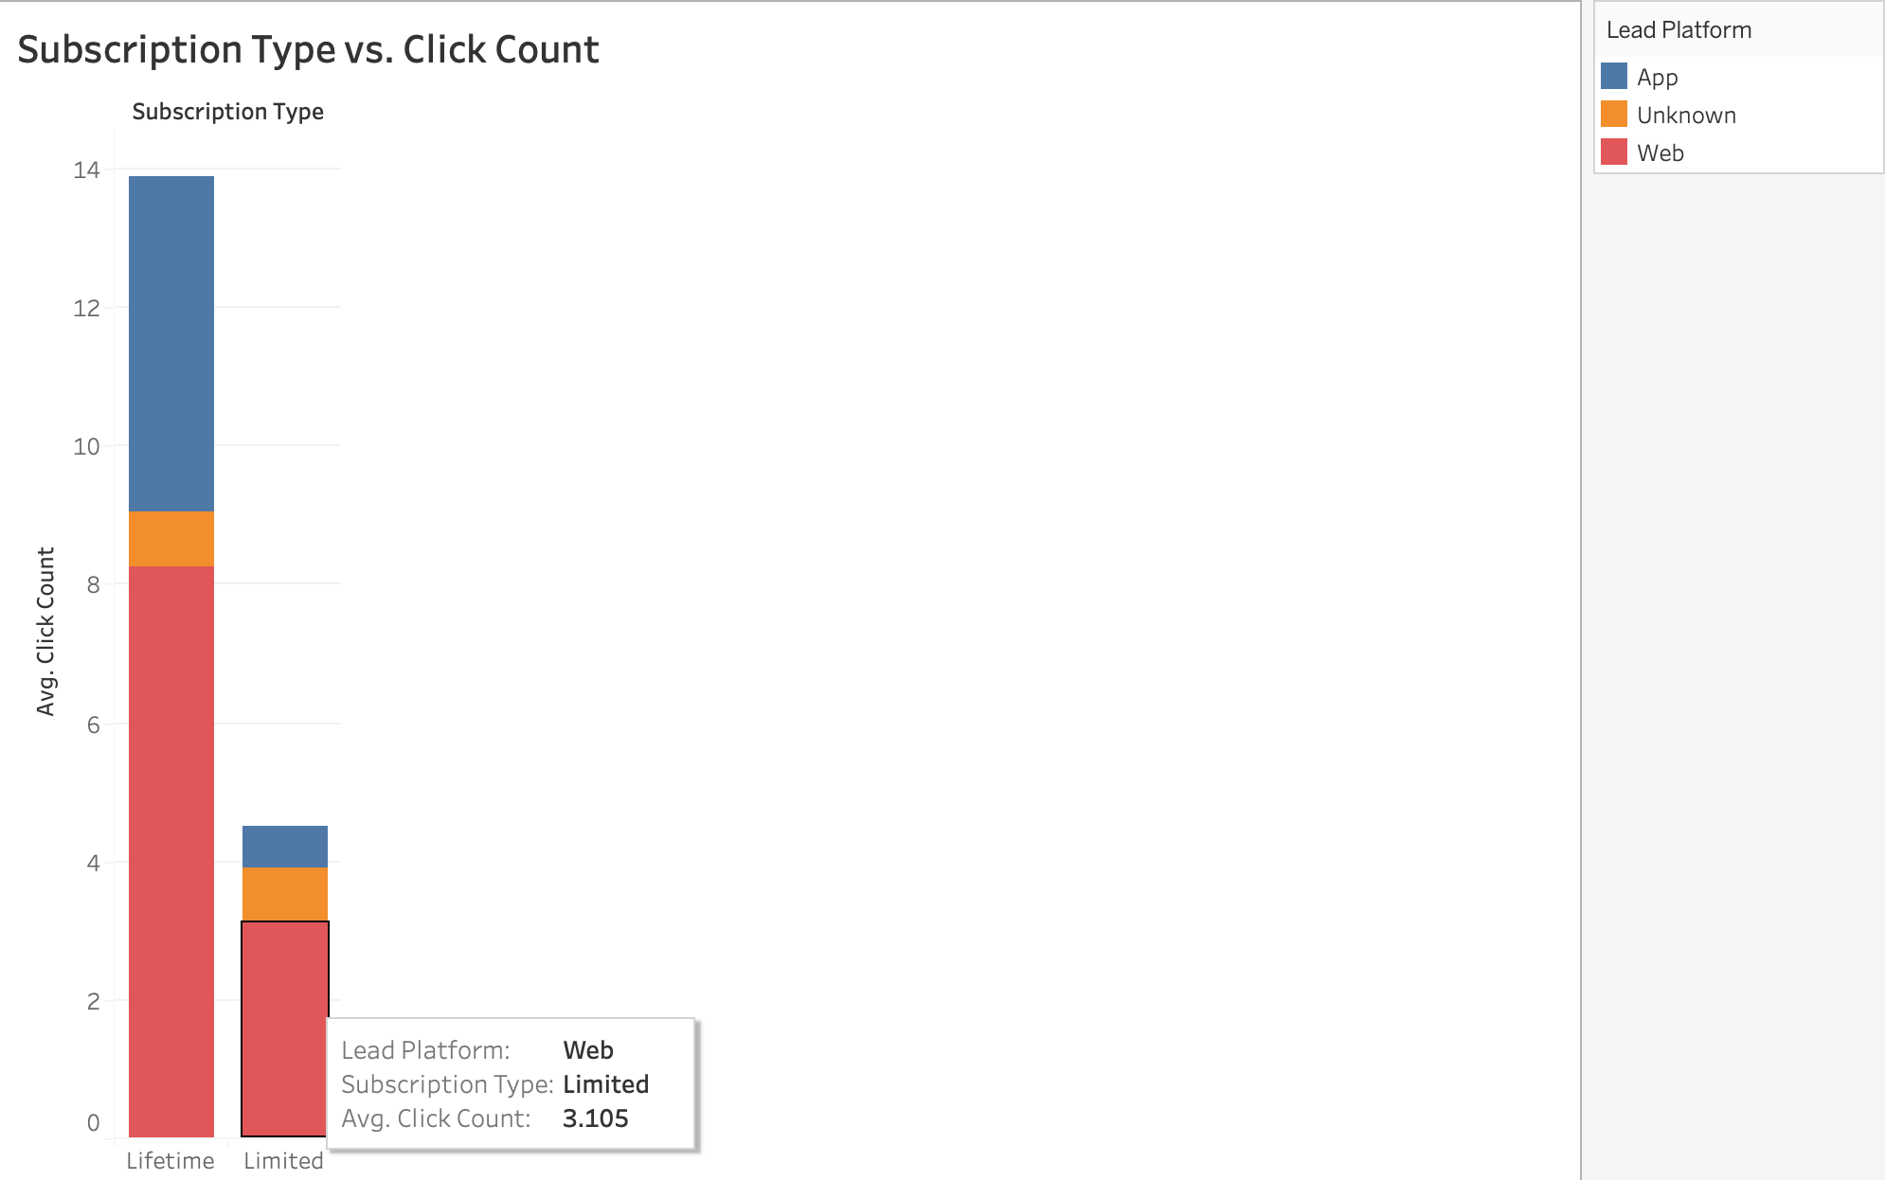
Exploratory Figures

Slide 4

Data Cleaning Process
Merge datasets based on ‘ID’
App:
Dropped null
Subscriber:
Load data and appropriate type conversion (Boolean, Category, Int/Float, Datetime)
Adjust ‘Purchase Amounts’ to account for extreme outliers
Feature Engineering
Standardize ‘Currency’ to USD
Updated ‘Country’ from self-reported to Currency-based location
Churn
‘Subscription Length’ in days from ‘Subscription Start Date’ - ‘Subscription Expiration’
Model Specific Manipulation according to Types
One Hot Encoding/Dummying
Z-Scoring
Notes:
Data cleaning steps, will complete once given. Used currency type to change country column, added specific countries rather than “other”, Original country column = self reported, unreliable
karla

Slide 5
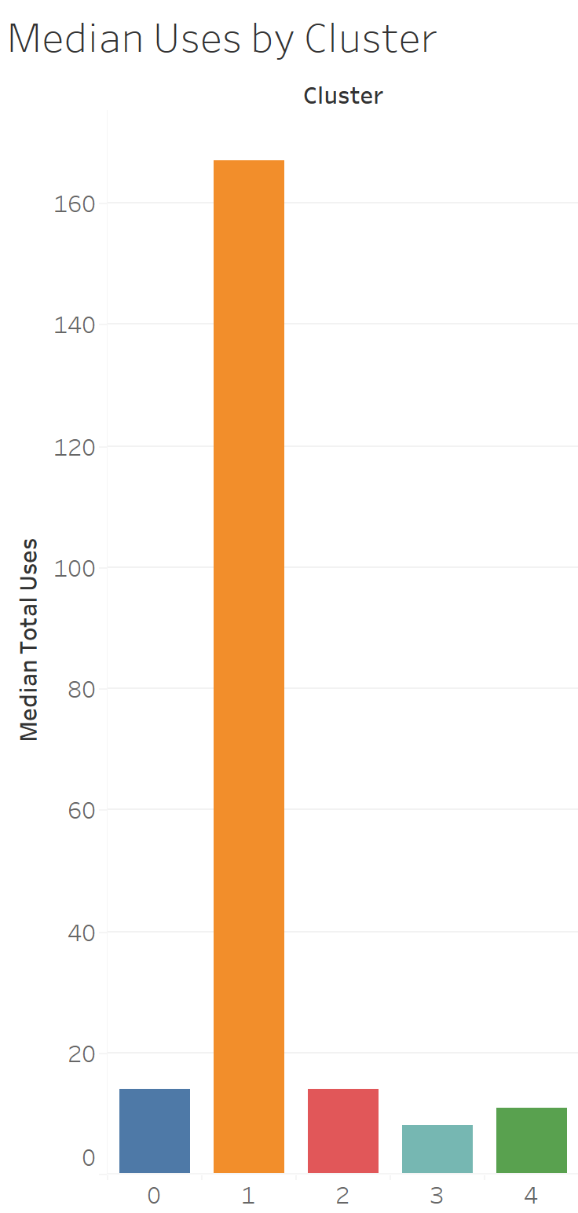
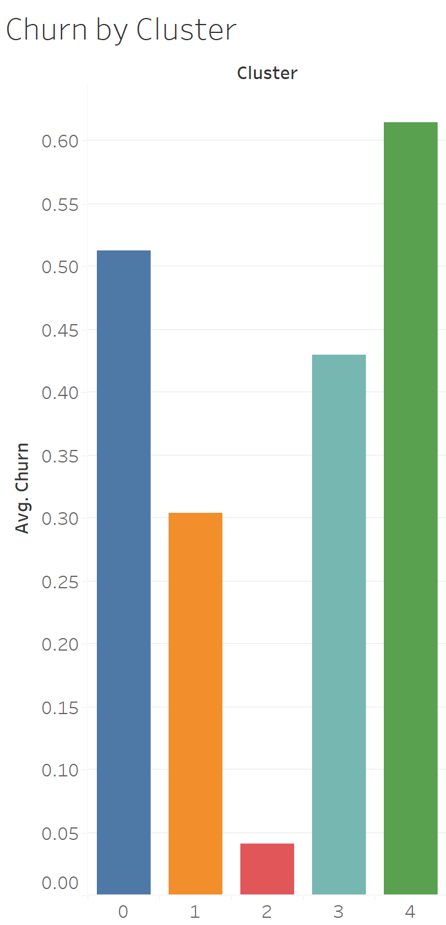
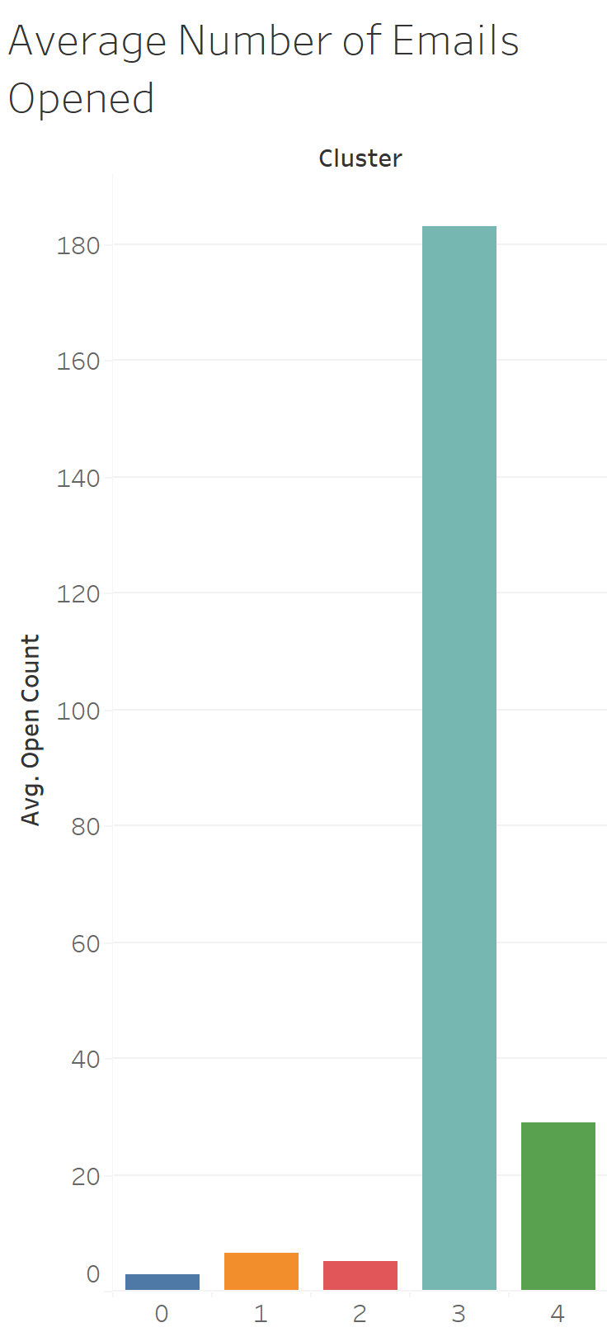
Subscriber Segments
Identifying user groups by
cluster
K-Means
Hierarchical Agglomerative
Spectral
With these assigned clusters, we can further understand our audience
Distinguish subscriber groups with the highest/lowest usage, churn rate, engagement, etc.
With this information, enact strategies for further involvement with these groups
Increase retention, drive interaction through certain platforms
Objective 2
Notes:
Overview of data
Karla

Slide 6
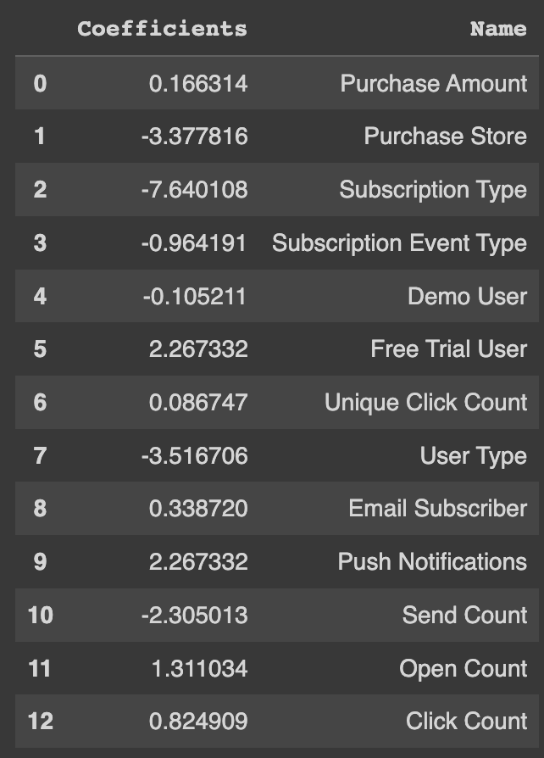
Targeting Subscribers - Product & Service Opportunities
79% of users located in the United States
Looking past a location approach
Which subscribers have the most purchasing potential?
Auto Renew on, Push Notifications on, is an Email Subscriber, Free trial…
Logistic and Decision Tree Models to predict Auto Renew
Coefficients
Feature Importance
Prioritizing visibility, outreach, and engagement
Objective 3
Notes:
Overview of data
christian

Slide 7
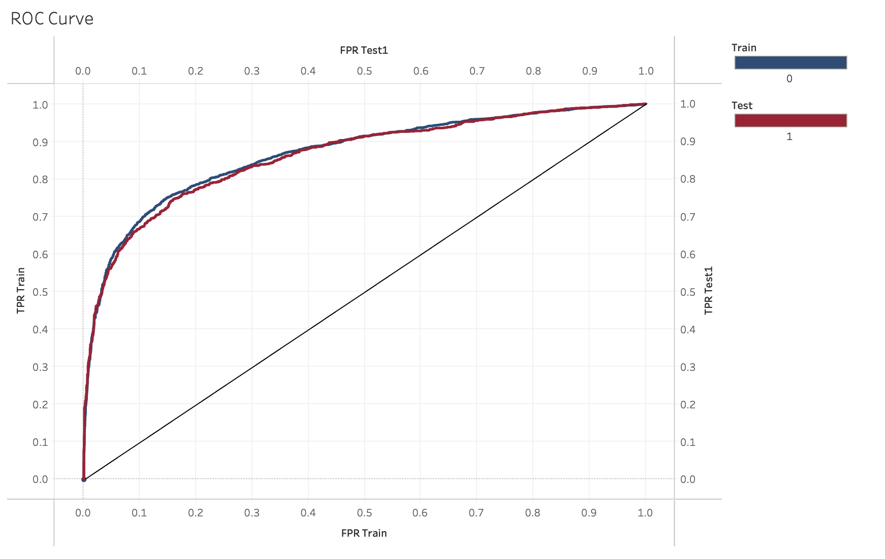
Barriers to Subscriber Engagement
Logistic Regression Model
Dependent Variable - Churn
Independent Variables - Purchase Amount, Send Count, Open Count, Purchase Store, Demo User, Free Trial User, Email Subscriber, Push Notifications, App Session Platform
Objective 4
Notes:
Overview of data
henry

Slide 8
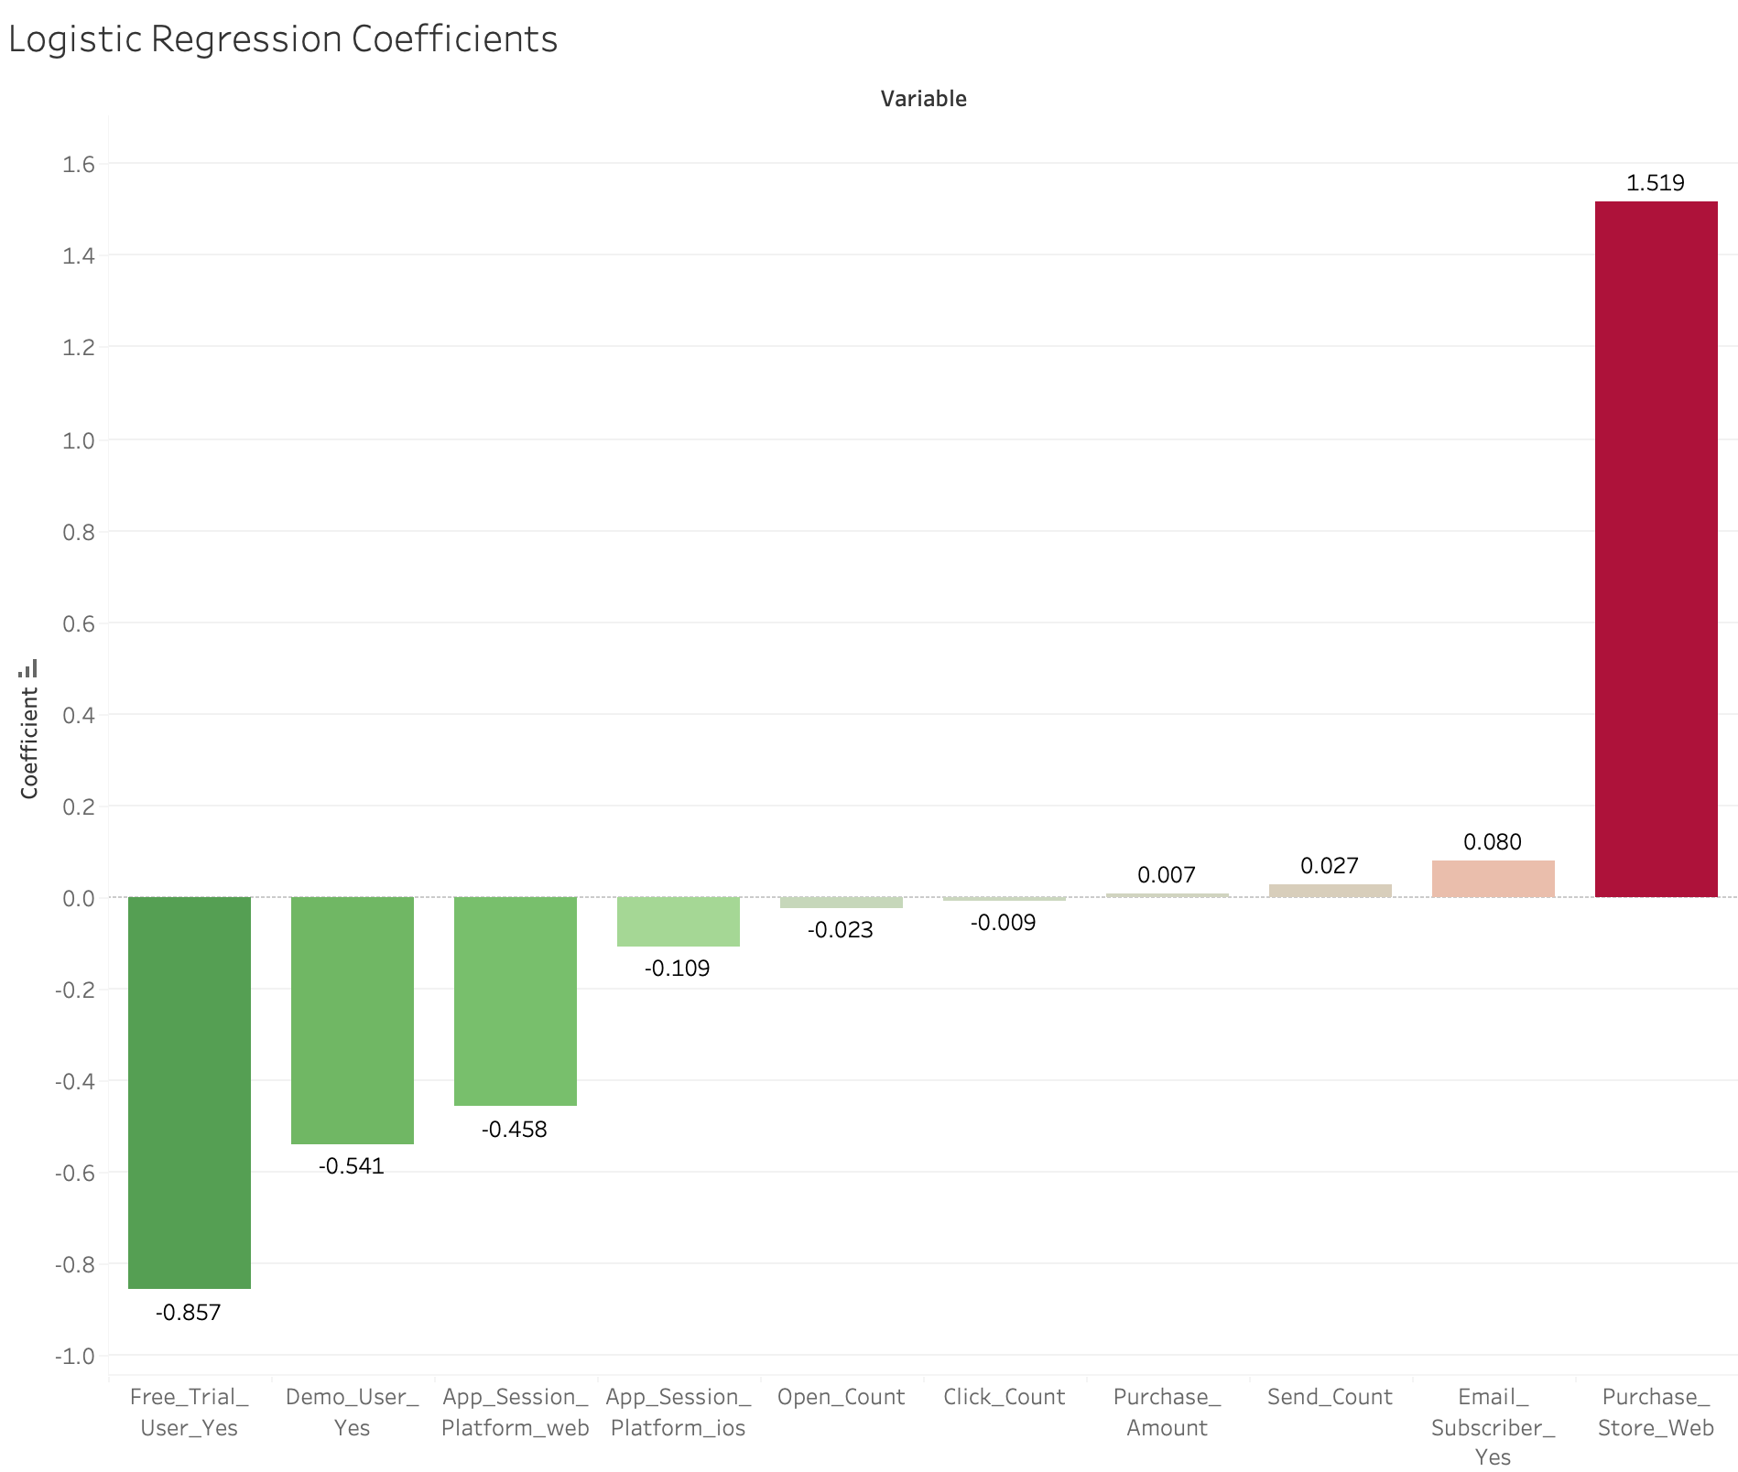
Barriers to Subscriber Engagement
Subscriber profile of those not continuing with the product
Identification of barriers to deeper subscriber engagement
Recommendations for improvement: personalized engagement, better onboarding, and addressing platform-specific issues
Objective 4
Notes:
Overview of data
henry

Slide 9

Most Valuable Subscriber
Purchase Amount (what we are predicting)
Auto Renew users -> Push Notifications, Email Subscriber
Push notifications, being an email subscriber, and auto renew gives insight as to who would likely buy more products
Those purchasing additional products and services would be considered valuable subscribers
Objective 1
Notes:
Overview of data
samara

Slide 10
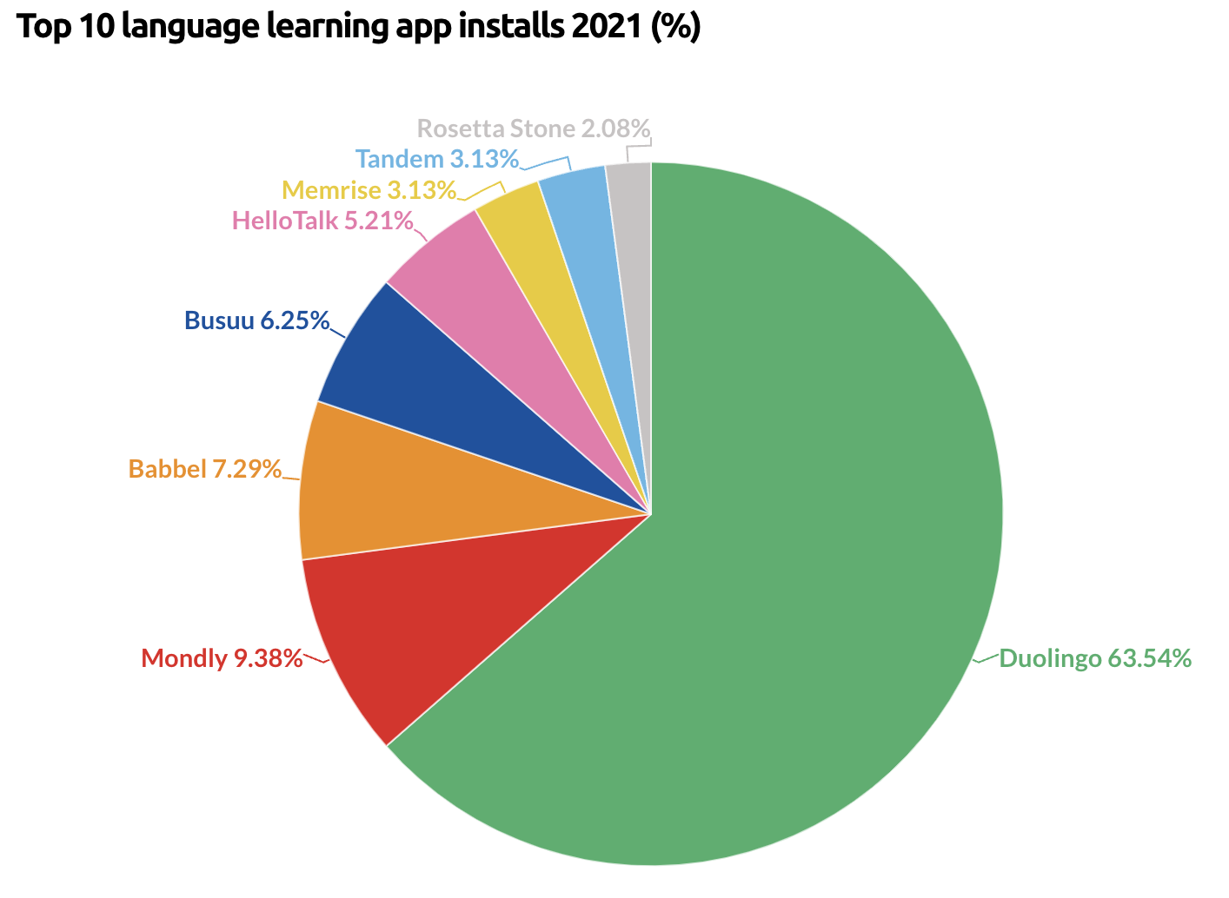
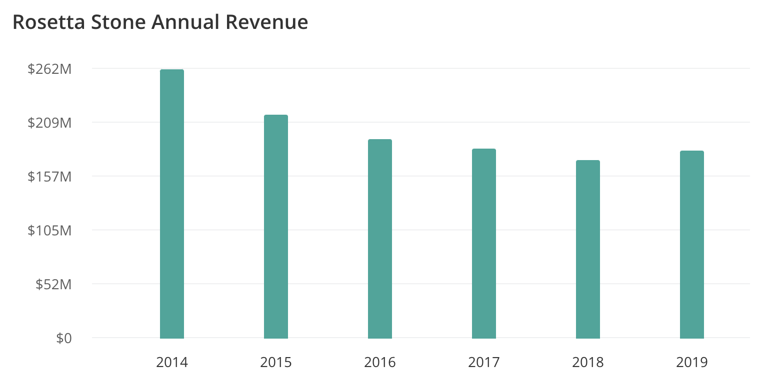
Relevant Business Opportunities
Evaluating Strengths and Weaknesses
Maintaining Relevance in the Language Learning space
Leveraging AI technologies to enhance tools/services
Capitalizing on Foreign Outreach
Stay Consistent with the Education Industry
Enter foreign education markets
Objective 5
Notes:
christian

Slide 11
Executive Summary
Identified valuable subscriber segments through assigned clusters from the model, revealing varying population sizes, usage, churn rates, and email engagement levels across these segments.
Noted potential for upselling to US-based subscribers, particularly those who have their push notifications turned on and are email subscribers. These users show higher engagement and visibility.
Profiling of discontinuing subscribers revealed that web-based purchasers, users not initiating with a demo or free trial, and non-interacting email subscribers are more likely to discontinue the product.
Barriers to deeper engagement were identified, including dissatisfaction from the web purchasing experience, ineffectiveness of email communication, and inconsistent user experience on different platforms (Android, iOS, web).
Proposed business opportunities include expanding to non-US markets, evolving the learning approach to a more interactive style, and focusing on education sectors worldwide.
Notes:
Waiting to complete once given structure of data information
samara

Slide 12
Thank you!
Notes:
MLA format

Slide 13
Softwares Used
Visualization
Tableau
Rguroo
Google Drive
Code
GitHub
Google Colab
Visual Studio
Python
Notes:
MLA format

Slide 14
References
Business of Apps. "Language Learning App Market." Business of Apps, 2021, https://www.businessofapps.com/data/language-learning-app-market/#:~:text=Duolingo%20was%20the%20dominant%20language,most%20popular%20apps%20in%202021.
Digital Journal. "Cloud-Based Language Learning Market Future Scenario, Growth Rate, Market Segmentation, and Industrial Opportunities to 2028 | Voxy, Inc., Rosetta Stone Inc., Culture Alley." Digital Journal, 2021, https://www.digitaljournal.com/pr/cloud-based-language-learning-market-future-scenario-growth-rate-market-segmentation-and-industrial-opportunities-to-2028-voxy-inc-rosetta-stone-inc-culture-alley.
Enlyft. "Rosetta Stone." Enlyft, https://enlyft.com/tech/products/rosetta-stone.
Langoly. "Rosetta Stone Review." Langoly, 2021, https://www.langoly.com/rosetta-stone-review/.
LinguaLift. "The 15 Best Language Learning Apps of 2021 That Actually Work." LinguaLift, 2021, https://www.lingualift.com/blog/best-language-learning-apps/.
Reddit. "Why is Rosetta Stone so bad?" Reddit, 2021, https://www.reddit.com/r/languagelearning/comments/pq4tjp/why_is_rosettastone_so_bad/.
Zippia. "Rosetta Stone Revenue, Number of Employees, Annual Growth and Compounded Annual Growth Rate." Zippia, 2021, https://www.zippia.com/rosetta-stone-careers-9940/revenue/.
Notes:
MLA format

